Slide 1
Props
Memory folder

Slide 2


AC22005
Section 2 - Lecture 5
Memory Management 1
Notes:
The idea of air traffic control is to be able to pack aircraft so close together that they need to be controlled.
Similarly, memory management is a requirement of more modern computers, because their memory has become so complicated that it needs to be managed.

Slide 3
Outline of today’s lecture
  The need for memory management
  Aims of memory management
  Memory partitioning schemes
  Reference: Stallings, “Computer Organization and Architecture” (5th Ed.), pp. 247-265

Slide 4

Thought for the Day

Slide 5
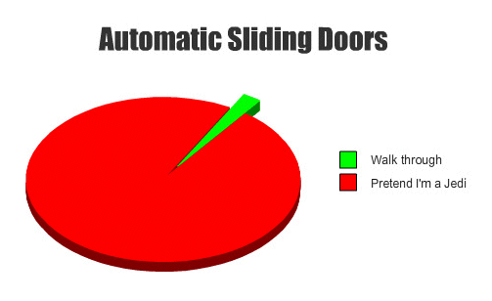
Graph of the Day

Slide 6
In the beginning * …
# of processors = 1
# of main memories = 1
# of simultaneous processes = 1
… therefore each process had exclusive use of the main memory and other system resources, and ran continuously on the processor ... so each process could manage this on its own (with or without an Operating System)
* e.g. in the 1980s with ZX computers, PC with MS-DOS

Slide 7
… then * …
# of processors = 1
# of main memories = 1
# of simultaneous processes > 1
… so now multiple processes are competing for use of the processor, the main memory and other system resources ... so we need to manage these resources and divide up the processor’s time between the processes … to do this fairly, we need an Operating System
* e.g. in the 1990s with Windows 3.1

Slide 8
… now
# of processors > 1
# of main memories = 1
# of simultaneous processes >> 1
… so multiple processes are competing for use of the processors, the main memory and other system resources ... so we still need an Operating System to perform the same management functions as before (we just have a bit more resource to call on).

Slide 9
Olde v new memory
SIMPLE COMPUTER
  <10 CPU registers
  (use is controlled by program code, not interchangeable)
  No cache (thus von Neumann bottleneck)
  No hard disk
  Backup storage (v. slow)
  Single process, one user
MODERN COMPUTER
  50-150 CPU registers
  (use is controlled by program code, may be interchangeable)
  L1, L2 and L3 cache
  (small, “expensive”)
  Hard disk available
  (could use to extend main memory - but it’s slow)
  Backup storage (v. slow)
  Multiple processes/users

Slide 10
Hard disk as memory?
The availability of a local hard disk means that data can be loaded/saved much more quickly than before (though still very slow cf. main memory) - this can be useful in a multi-process environment.
As hard disk storage is large and “cheap” cf. main memory, there is also the possibility of using the hard disk to enlarge the apparent size of the main memory (if we can allow for its slow speed) ... this is virtual memory.

Slide 11
Multi-level memory
For practical and economic reasons, today’s PCs have a multi-level memory structure:
CPU registers
L1 Cache
L2 Cache
L3 Cache
Increasing speed / “cost”
Increasing size
Main memory
“Virtual” memory
Hard disk storage
Backup storage

Slide 12
Multi-level memory
CPU
Main Memory
Magnetic disk
Registers
Cache
FASTEST
“Most Expensive”
Smallest Capacity
SLOWEST
“Cheapest”
Largest Capacity

Slide 13
Remember ...
  memory address and register usage is governed by the program code being run
  main memory is never big enough!
  cache is new, but is automatically handled by hardware (so needs no management)
  backup storage is used “offline” (so effectively can be disregarded)
  hard disk is much slower than main memory (and non-volatile) but it is also much larger and “cheaper”

Slide 14
What is
Memory Management?

Slide 15
Use of Memory
Consider the common situation where a PC is running a variety of processes over time, so processes are constantly being loaded from disk (necessary for execution) and unloaded from memory (to free memory for other processes).
The OS will perform memory management to:
  allocate memory as efficiently as possible
  keep track of those sections of memory which are free and which are in use (and which process is using each section).

Slide 16
What is Memory Management?
Management of memory usage was not necessary in single-process systems - every process had the whole memory to itself.
Now, many processes have access to the same main memory space, and management is needed to handle the memory resources of a computer as efficiently as possible.
It is a partly static, partly dynamic process, and is governed by the OS, with support from the processor.

Slide 17
Aside - Resource Management
In addition to memory management, there are also the issues of:
  process management (known as scheduling)
  disk management
  management of other resources, such as networks and printers
These are primarily OS functions, so will be covered in the later section of the module.

Slide 18
Memory Management Aims
A primary function of memory management is to bring processes and data from secondary storage (usually hard disk) into main memory ready for execution (this includes virtual memory).
To do so, the following sub-aims are highly desirable:
  Protection
  Sharing
  Relocation

Slide 19
Sharing and Protection
Sharing: in multi-user and multi-program environments, the same program or same data can be used multiple times - it would be memory efficient if only one copy of each was stored i.e. code shared between processes
Protection: similarly, we need to prevent unauthorised programs accessing areas of memory allocated to other processes, so the operating system must protect processes i.e. memory areas “fenced off”

Slide 20
Relocation
As the main memory is in a novel state when a process is loaded, the process must be capable of being loaded into any part of the address space (no hard-coded addresses).
Relocation requires that data pointers and branch pointers within the program can be accessed in a relative manner via a base address (the start address of the program) and a logical address (which is relative to the base address). This is done by the compiler.

Slide 21
Relocation
Main Memory
Disk
1st time process
is executed
Process
2nd time process
is executed

Slide 22
Memory Allocation

Slide 23







Slide 24

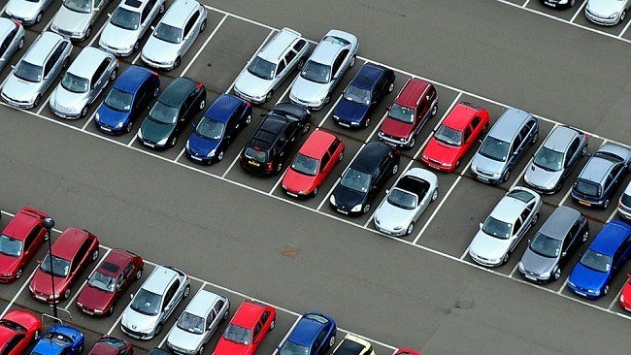

Slide 25
How is memory allocated?
When a process is loaded, it must be placed into memory - as efficiently as possible.
If insufficient free memory is available, we must remove another process (to free some memory).
Several partitioning schemes are possible:
  fixed-size partitions
  variable-size partitions
  segmentation
  paging

Slide 26
Fixed-size partitions
When a process is loaded, it is placed into the smallest free partition which is large enough to take all of it (if no such segment is free, a process must be unloaded first).

Slide 27
Fixed-size - analysis
  there is always memory wasted at the end of the segment
  when a process is unloaded, the whole segment is freed
  data structures may be able to grow, but there will be a limit

Slide 28
Variable-size partitions
When a process is loaded, it is assigned the first available section of memory large enough for it (if none free, must unload process first).
Initially …
Later …
Eventually …

Slide 29
Variable-size - analysis
  no memory is wasted when loading processes
  as time goes on, more and more small fragments of unused memory are left behind (fragmentation); defragmentation of memory is possible by compaction, but this is time-intensive.

Slide 30
Segmentation
When a process is loaded, it is itself segmented in order to fit into available memory spaces.

Slide 31
Segmentation - analysis
  fragmentation of free memory is eliminated, but process itself becomes fragmented (not a problem, if we keep track of the segments)
  data structures that grow and shrink can be handled more easily
  different protection properties can be given to each segment
  hardware support in current CPUs

Slide 32

Paging
Page
FRAME
When a process is loaded, it is divided up into relatively small fixed-size pages. Memory is divided into frames of the same size. Process pages are loaded into the minimum required number of frames.

Slide 33
Paging - analysis
  at most, only a fraction of one frame is wasted when a process is loaded
  when process is unloaded, the space which is freed is in page-sized sections, so is readily re-used by next process
  the frames used by a process need not be contiguous in memory, so relocation is very flexible
  there is some fragmentation, but it does not get worse as time progresses

Slide 34
Efficient memory usage
Paging offers other advantages. If a process is divided into pages, we need only load the page actually being processed. This means that:
  we can start running a process as soon as the first page is loaded
  we can have pages from many processes in main memory, maximising the multi-processing capabilities of the system
  we can run processes that are actually larger than the main memory!

Slide 35
Partitioning - summary
  All of these partitioning schemes have their own advantages and disadvantages
  Any particular operating system will generally be set to use one scheme, so the scheme in use will be fixed for the duration of operation

Slide 36
Lab Connection
  You will work through some examples of segmentation in the computer-based tutorial in Lab Session 3

Slide 37
Summary
We have seen:
  the need for memory management
  aims of memory management
  memory partitioning schemes
Next meetings:
  Tuesday at 12noon - lab on TOM / C#
  Thursday at 1pm - more on memory management

